Slide 1


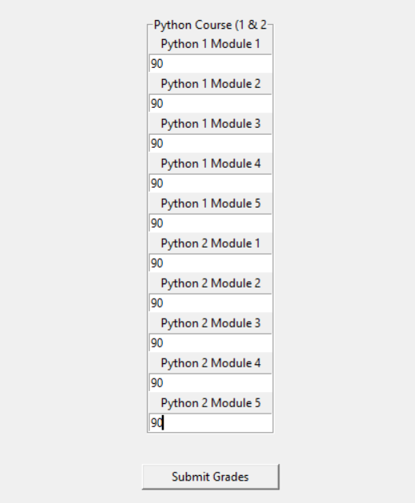


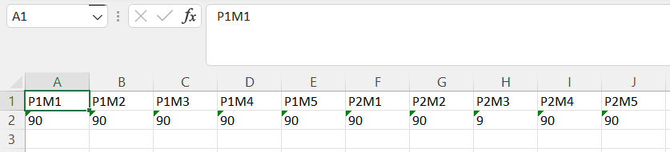
Grade Tracker GUI
Coded by Daniel DiResta
https://github.com/ksu-is/GradeTrackerGUI
Keeping track of your grades during a semester can be overwhelming but there is a solution. The Grade Tracker GUI is a graphical user interface that takes grade inputs for assignments and places them into an Excel file. No more hassle and more time coding!

